Slide 1
Structured Programming
ET0083

Slide 2
Contents
Computer Basics
I/O & Data types
C++ Operators
Selection Constructs
Iteration Constructs
Functions
Array & Strings
Bitwise Operations

Slide 3
Assessment
Assessment Components | Weighting
Lab Test 1 | 15%
Lab Test 2 | 15%
Lab Test 3 | 20%
Supervised Online Mid-Module Quiz | 15%
Supervised Online End-Module Quiz | 15%
Unsupervised Quizzes (On going) | 10%
General Performance | 10%
Total | 100%

Slide 4
Computer Basics
Chapter 1

Slide 5
Introduction
A computer system is made up of Hardware and Software.

Slide 6
Hardware
The hardware is the actual physical devices of the computer system.
The hardware requires to be given instructions to tell what to do.

Slide 7
Basic Computer Architecture
Computer system consists of 4 main parts:
CPU, Memory, IO Interfacing Circuitry, 3-Bus System
Data Bus
I/O
Interfacing Circuitry
Central
ProcessingUnit
Memory
Control Bus
Control Bus
Address Bus

Slide 8
Central Processing Unit
Controls system operations
Does arithmetic & logic operations
Data Bus
ALU
Clk
Clock
RD
Control
Bus
Control Unit
WR
Address Bus

Slide 9
Memory
Stores programs and data
Two different types:
  Primary memory:
    Random Access Memory (RAM)
    Read Only Memory (ROM)
  Secondary memory:
    Hard disks
    DVD-ROMS
    USB Thumb drives..etc.

Slide 10
Memory
Example of a 640K memory structure
Address in Hex
0x00000
#7
#6
#5
#4
#3
#2
#1
#0
One Byte
= 8 bits
0x00001
0x00002
0x9FFFF
0xA0000

Slide 11
I/O Interfacing Circuitry
Data Bus
Speaker
Speaker Circuit
Printer
Printer Circuit
Keyboard
Keyboard Circuit
Monitor
Monitor Circuit
Address Bus
Microphone
Audio Circuit
Mouse
USB Circuit

Slide 12
Software
A set of instructions that tell the computer system what to do is called a Computer Program.
Computer Programs are written in different languages.
Can you name some examples of programming languages?

Slide 13
Computer Languages three categories
Machine Language
Assembly Language
High-Level Language
H/W

Slide 14
Machine Language
The hardware of a Computer can only understand binary data
  i.e. 0 and 1.
A computer is designed to understand a given set of instructions, where each instruction has a Binary Code.
This Binary Code is called Machine Code.

Slide 15
Assembly Language
Assembly language is one level above Machine Language.
It uses alphabetic abbreviations called Mnemonics that can be easily remembered.
  ADD for addition
  SUB for subtraction
  CMP to compare

Slide 16
Assembly Language
Although more easily understood by humans, they cannot be directly understood by the Computer.
Therefore, an Assembly Language Program must be translated into Machine Code by an ASSEMBLER.
Although Assembly Language is easier to use than Machine Language, it is still tedious and prone to error.

Slide 17
High-Level Language
It consists of statements that are similar to English and uses everyday mathematical notations.
A single High-Level Language statement is equivalent to many Machine Code instructions.
Once you learn a High-Level Language, you can program any Computer that supports that language.

Slide 18
High-Level Language
Your program, written in high-level language, cannot be understood and run by the computer.
It must be translated to Machine Code.

Slide 19
Two types of translation
COMPILER - translates the entire program into Machine Code before it is executed.
INTERPRETER- translates and executes the High-Level Language statement one at a time.

Slide 20
C++ Language
C++ is the High-Level Language used in this Module.
It was developed from C Programming Language.
C was developed by Dennis Ritchie at the AT & T Bell Laboratories for the implementation of the UNIX Operating System.
C is a very popular language used in industries today, especially for engineering applications.

Slide 21
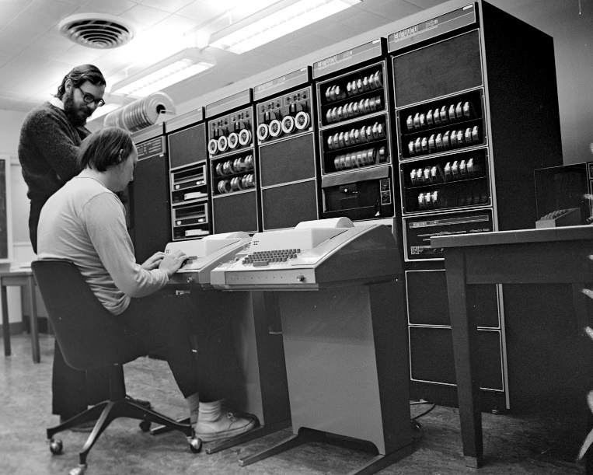
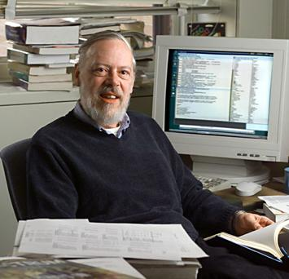
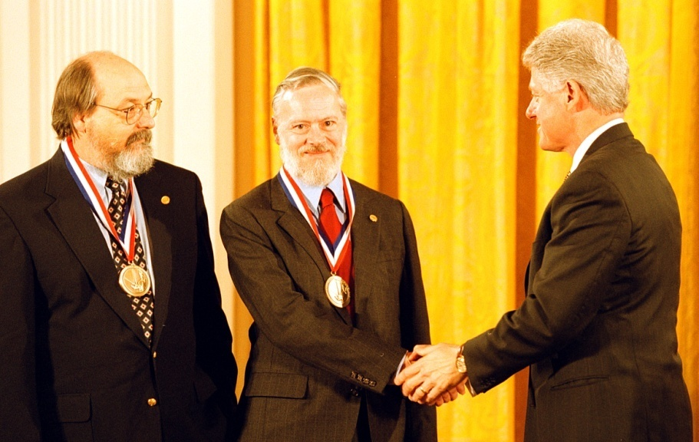
Developer of the C Language
Dennis Ritchie & Ken Thompson with PDP-11
Dennis Ritchie
Ken Thompson (left) and Dennis Ritchie receive the National Medal of Technology from President Clinton in 1999.
Search
Web

Slide 22
Source Code to Executable Code
Source Code
Hello.cpp
Compiling process
Other Object Code
Object Code
Hello.obj
Other Object Code
Linking process
Executable Code
Hello.exe

Slide 23
Exercise 1: Computer Basics & Designing Programs
1. A computer system is made up of __________ and __________
2. What are the 4 main parts in a basic computer architecture?
3. What is a compiler used for?
4. Why is it easier to program in high-level languages than in machine language or assembly language?

Slide 24
Designing Programs
Write the problem statement.
Define the Inputs, Computation & Outputs.
Generate test data.
Write the Algorithm using Pseudo-Code (or Flow Chart)
Translate the Algorithm into a Program (Coding).
Compile, debug and test the program
Major Steps

Slide 25
Algorithms
An algorithm is the method to solve a problem.
An algorithm can be expressed as a set of instructions/activities for accomplishing a task.
We deal with algorithms for doing everyday things
  Preparing our favourite dish
  Building a DIY Computer

Slide 26
Algorithms can be expressed in two ways – Flowchart or Pseudocode.
Flowchart is a graphical technique.
Pseudocode is a textual representation.

Slide 27
Flowcharts
Flowcharts use a set of graphical symbols to represent the flow of actions in a program.
Flowcharts are more easily and quickly understood than pseudocode as they have more visual impact.
However, flowchart is not so convenient when frequent modifications have to be made to an algorithm.

Slide 28
Example
Start
Read num
Display error
Message
Is
num < 0?
Yes
No
Increase num by 1
Display num
Stop

Slide 29
Writing algorithms using Pseudocode
Design a program to calculate a person's age in months, and then in days. You are given the age in years.
  What are the inputs needed by the program?
  What does the program have to calculate?
  What results must the program output?

Slide 30
2nd Step
Define the Inputs, Computation & Outputs
Inputs : Name
Age (in Years)
Computation : Age in Months = 12 x Age
(Processing) Age in Days = 365.25 x Age
Outputs : Name
Age (in years)
Computed Values

Slide 31
4th Step
Write the Algorithm using Pseudo-Code
Pseudo-Code is just an informal way of writing an algorithm.
We will be using the convention below for writing algorithms in Pseudo-Code.
  1.0 Major Step 1
  2.0 Major Step 2
  3.0 Major Step 3

Slide 32
As more details are added to each step,
1.0 Major Step 1
1.1 Detail 1 of Step 1
1.2 Detail 2 of Step 1
:
2.0 Major Step 2
2.1 Detail 1 of Step 2
2.2 Detail 2 of Step 2
:
3.0 Major Step 3
3.1 Detail 1 of Step 3
:

Slide 33
The first level of Pseudo-Code
1.0 Read Name and Age
2.0 Convert Age to months and to days
3.0 Write Name, Age and Computed Values.

Slide 34
second level pseudo-Code :
1.0 Read Name and Age
1.1 Read Name
1.2 Read Age
2.0 Convert Age to months and to days
2.1 AgeInMonths = 12 x Age
2.2 AgeInDays = 365.25 x Age
3.0 Write Name, Age and Computed Values
3.1 Write Name, Age
3.2 Write AgeInMonths, AgeInDays
The above Algorithm may be refined further, adding still more details if necessary.

Slide 35
Top-Down Program Design
This process of refinement by adding successive layers of details is known as Top-Down Program Design.
Once the algorithm has been written as shown above, it is very easy to perform the fifth step and translate it into a program.

Slide 36
Activity
Design an algorithm to find the Area of a Right-Angled triangle.
Area = ?
H
B

Slide 37
Three major steps :
a. Step 2:
Define the Inputs, Processing & Outputs
b. Step 4:
Write the Algorithm using Pseudo-Code or Flowchart
c. Step 5:
Translate the Algorithm to a Program

Slide 38
2nd Step : Define the Inputs, Computation and Outputs
Inputs :_____________________
Computation :___________
(Processing)
Outputs : __________________________
Two sides of the triangle, H & B
Area = 0.5 x H x B
Input values (H & B) and Computed value (Area)

Slide 39
4th Step : Write the Algorithm using Pseudo-Code
1.0 ____________________________
2.0 ____________________________
3.0 ____________________________
Read the two sides of the triangle, H & B
Compute the Area
Display the two sides, H & B with the computed Area

Slide 40
We could now write the second level Pseudo-Code.
1.0 ____________________________
1.1 ______________________
1.2 ______________________
2.0 ____________________________
2.1 ______________________
3.0 ____________________________
3.1 ______________________
3.2 ______________________
Read the two sides of the triangle, H & B
Read value for H
Read value for B
Compute the Area
Area = 0.5 x H x B
Display the two sides, H & B with the computed Area
Display the two sides, H & B
Display the computed value Area

Slide 41
The 5th Step, translate the Algorithm into program
Template of a C++ program
int main()
{
statements;
}

Slide 42
Exercise 1: Computer Basics & Designing Programs
5. What is an algorithm?
6. In the following questions, apply the design & development process up to Stage 4 only. Use both pseudocode and flowcharts in your algorithm.
a. Design a program to add three integer numbers.
b. Design a program to calculate the sum and difference of two whole numbers.
7. Design an algorithm in flowchart to display the smaller number of any 2 numbers input to the program (or keyed in by the user).

